Slide 1
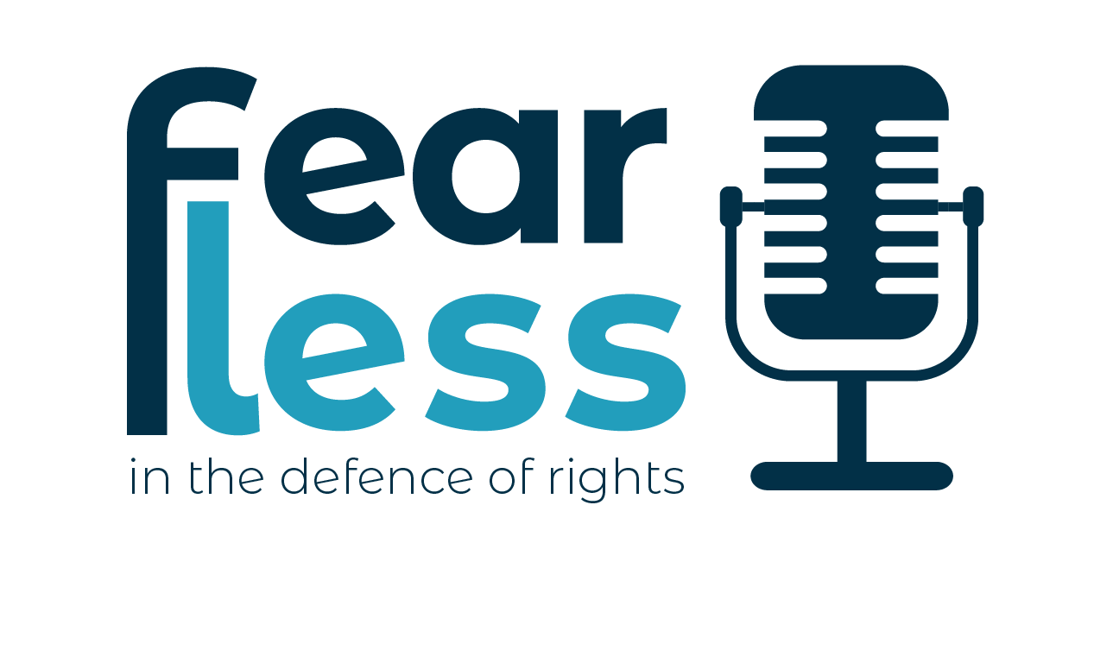
CDAS Conference Why rights-based community development?
27th September 2023
#FearlessScot
@AFSEE
@Rights_Real
@Clare_MacG
@fearlesspodscot
@IACD_global
Notes:
Thank you for inviting me to speak today – it’s a real honour.
I look forward to hearing more today about how so much of it is in rooted in seeking transformational change with communities.
I want to acknowledge the privileged position I hold as a white Scottish woman from the global north –.
I’m Clare MacGillivray, the Director of Making Rights Real – a grassroots charity that supports communities in Scotland to name and claim their rights.
We work alongside marginalized communities to collectively organize around their human rights issues, to hold duty bearers to account and campaign on human rights issues.
I’m also a senior Atlantic Fellow for Social and Economic Equity
I am a Trustee with IACD and an UNFEARTIE – which is a defender of children’s human rights at the Children’s Parliament in Scotland.
I’ve been invited to speak about “Why CD? And want to focus on Why rights based CD??” – a topic I’ve been exploring since last year with the Atlantic Fellowship at LSE. – and this presentation has grown out of the AFSEE research in 2022 and a podcast series @fearlesspodscot
Do tweet about us and lets get the conversation going online about rights based CD.

Slide 2
What I’ll cover
Community development as a rights-based practice
The human rights context in Scotland
Some wicked questions…
Notes:
Here’s what I’ll cover in this short session:
So, I want to hand that back to you.
Hands up if you’re a human rights defender?
Would you describe yourself as a human rights defender?

Slide 3
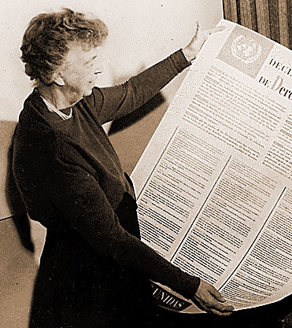
“Where, after all do universal human rights begin? In small places, close to home, so close and so small that they cannot be seen on any map of the world. Yet they are the world of the individual person: the neighbourhood he lives in; the school or college he attends; the factory, farm or office where he works…
Unless these rights have meaning there, they have little meaning anywhere.”
E. Roosevelt
Notes:
Why are human rights important in communities?
When talking about the Universal Declaration of Human Rights at its launch in 1948, Eleanor Roosevelt stressed that human rights must have meaning in the ‘small places, close to home’.
“Where, after all do universal human rights begin? In small places, close to home, so close and so small that they cannot be seen on any map of the world. Yet they are the world of the individual person: the neighbourhood he lives in; the school or college he attends; the factory, farm or office where he works…
Unless these rights have meaning there, they have little meaning anywhere.”
E Roosevelt

Slide 4
Change doesn’t happen quickly enough for the people who need change most
Notes:
We know that change doesn’t happen quickly enough for the people who need change most.
In their small places close to home.

Slide 5
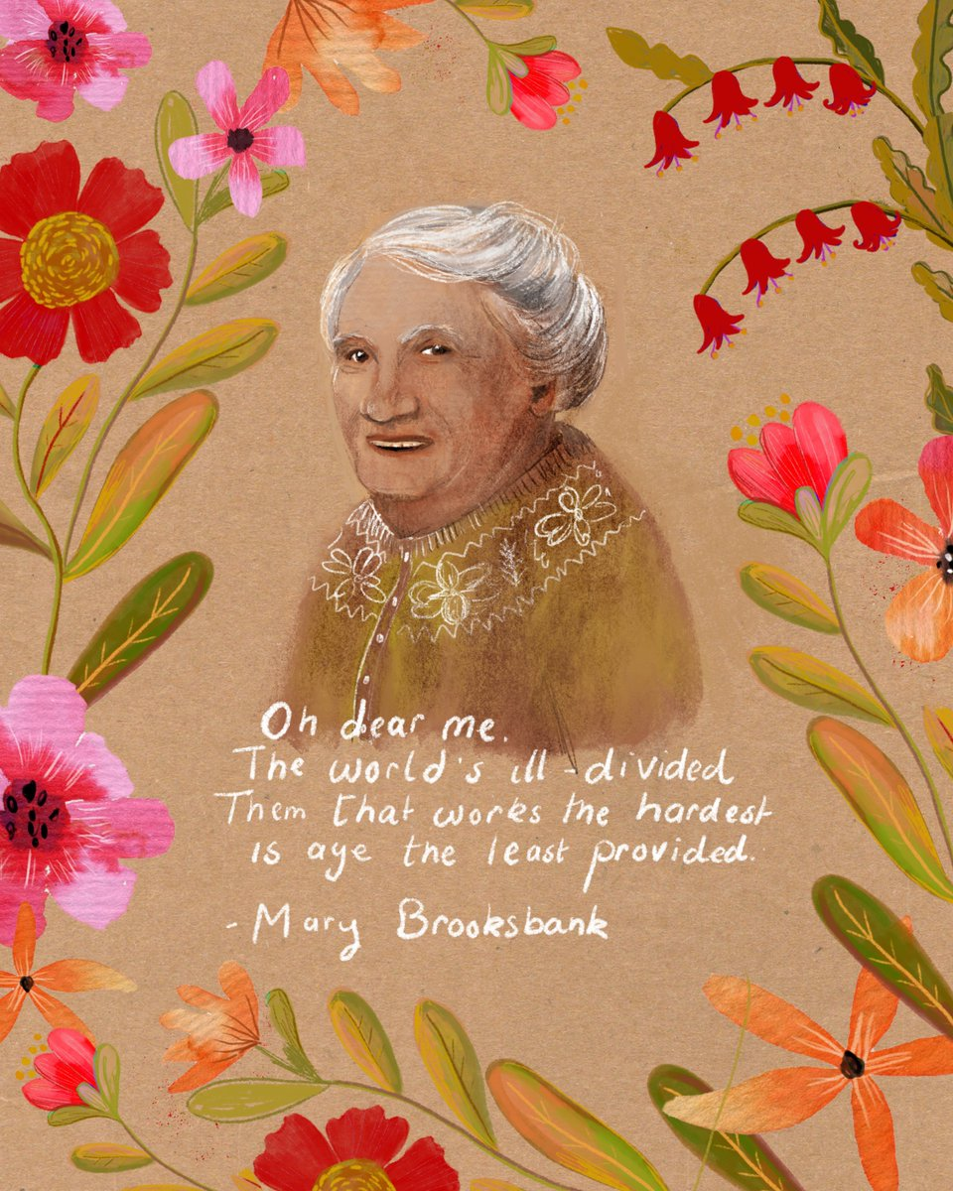
The context
We are facing incredible challenges globally
Credit: Gillian Gamble
www.gilliangamble.org
@GillGamble
Notes:
Here are some of the assumptions I’m making in exploring this topic.
We are facing incredible challenges globally:
Environmental catastrophe
Neo-liberal economies which uphold power structures and marginalize communities to embed structural inequality
Rise of right wing populism and a disturbing rise of racism
Global inequalities – including health inequalities recovery from trauma of covid
Increased areas of war, conflict and violence
These issues are not experienced equally - in the words of Mary Brooksbank – the socialist, trade union activist, songwriter and weaver from my home town of Dundee, in Scotland “Oh dear me, the world is ill divided. Them that work the hardest are aye the least provided.

Slide 6
Why rights-based CD?
Inequality is not inevitable
We can transform structural inequality
People build COLLECTIVE social movements
We can use human rights based community development to change systems
“What do human rights defenders need to flourish?”
Notes:
BUT – there is hope.
If we make assumptions that.
Inequality is not inevitable
We can transform structural inequality
People build social movements
We can use human rights based community development to change systems
And if we believe that through collective action we can use human rights to change systems – we need to ask what do HRDs need to flourish?

Slide 7
“Human rights defender is a term used to describe people who, individually or with others, act to promote or protect human rights in a peaceful manner.”
United Nations Declaration on Human Rights Defenders
Notes:
So, what is a human rights defender?
UN Declaration on Human rights Defenders is 25 years old this year.
HRDs are defined as people who, individually or with others, act to promote or protect human rights in a peaceful manner. This could be in a voluntary role or in paid employment.”
The declaration:
Represents a paradigm shift: it is addressed not just to States and to human rights defenders, but to everyone. It emphasizes that there is a global human rights movement that involves us all and that we all have a role to fulfil in making human rights a reality for all.
There is a Special Rapporteur for HRDS – currently Mary Lawlor

Slide 8
“Human rights defenders are agents of change, and their ability to operate safely and freely is a vital element of an open society. Supporting them is one of the most effective ways to create just, equal and open societies with human rights and access to justice for all.”
Amnesty International On the Human Rights Frontline
Notes:
Amnesty has said “Supporting HRDs is one of the most effective ways to create just, equal and open societies with human rights and justice for all.”
HRDs are in every field and discipline in every country. And are often uncredited for their successful, tireless and often dangerous work to advance human rights for all.
As community development workers, activists or community members we might not describe ourselves as a human rights defender – but if we are working with or as rights holders to hold duty bearers to account, to tackle injustice and human rights issues – then we are.

Slide 9
Rights based community work
Community work as a rights based profession / practice
Communities at the heart of challenging power structures to advance human rights
Neoliberal system exacerbates inequality, racism, misogyny
Human rights defenders speak truth to power
Success in shifting systems to advance human rights for all
Defending the rollback of human rights
Notes:
Community development is a rights based profession and practice
Human rights are at the heart of our values and standards as a profession and should be embedded in our practice
International HR treaties and the principles of a HRBA should be embedded in what we do to support communities to challenge power structures which are repressive.
the PANEL principles of a rights based approach put the participation of rights holders at the centre of social change work
Community workers are at the heart of challenging structures / holding the state to account, shaking the tree of power to challenge institutional racism, misogyny, colonialism
We know Power has been built up in the hands of the few over centuries
This neo-liberal system which concentrates and exacerbates wealth and power in the hands of the few – continues to marginalise communities
We cant talk about challenging systems without talking about power
And the risks that speaking truth to power brings risks to human rights defenders
We often don’t celebrate the success of HRDs to shift systems to advance human rights. But there are many.
And we can’t stop now. The rights we have won sit precariously on edge and we need to fight to protect against the rollback of our rights – UK Gov.

Slide 10
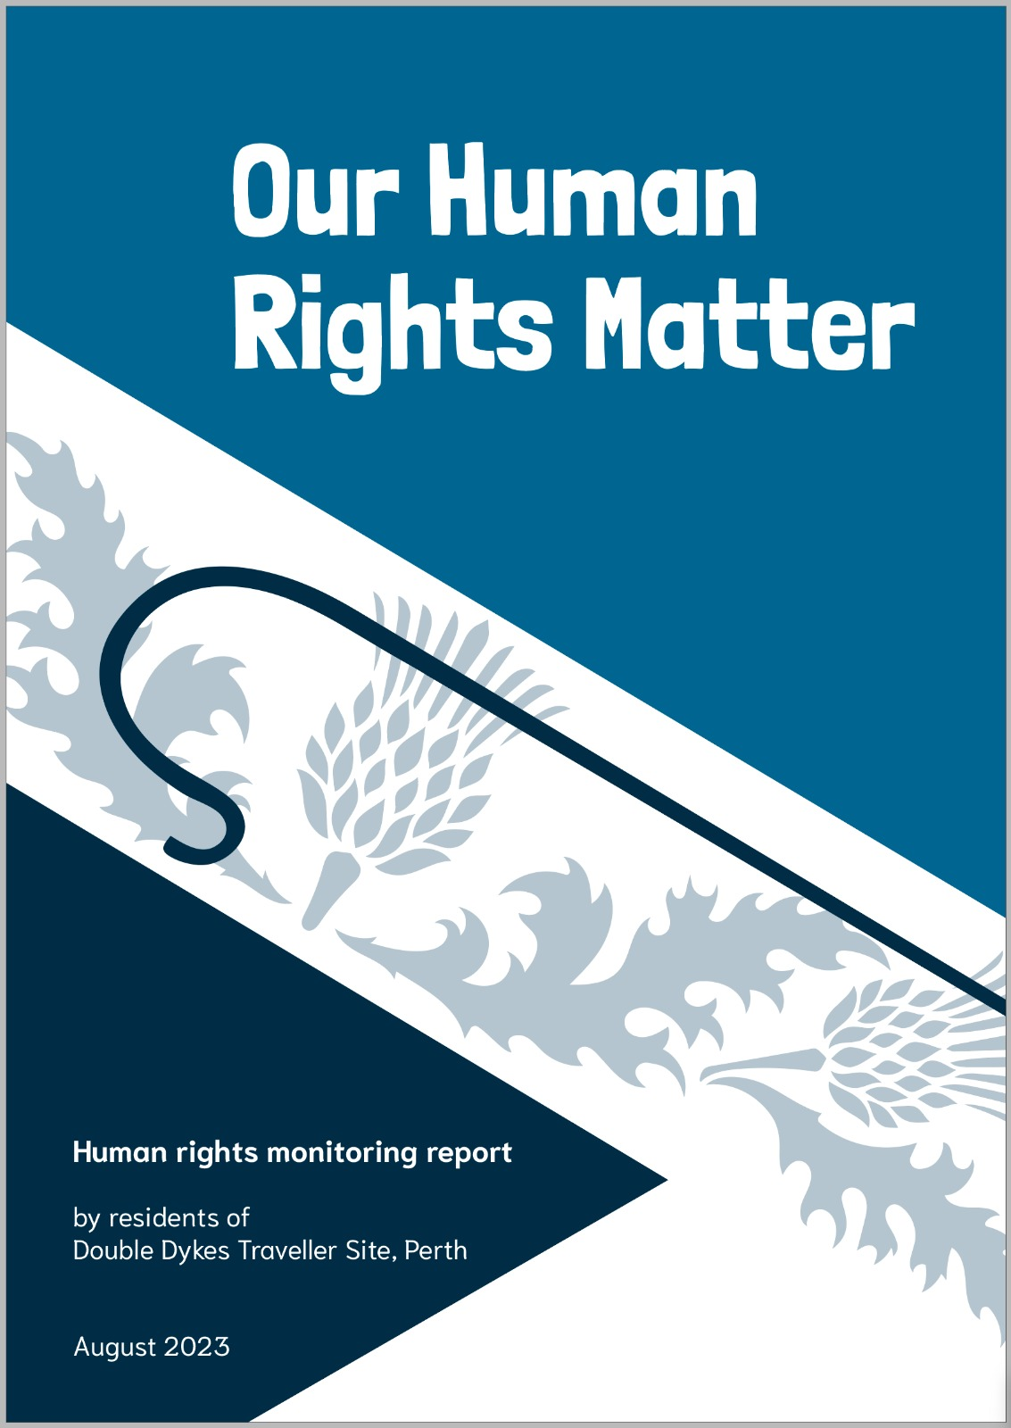
An example of rights based practice
Our Human Rights Matter
Notes:
The following few slides use Arial for the text – which all powerpoints will have and be able to use

Slide 11
What we did
Our Human Rights Matter
April 2022
Listened about people’s experiences of life at Double Dykes
Developed a survey. Half of all households took part.
People said what they liked about living at Double Dykes and what needed to change
Set indicators for change and an accountability framework using rights
Hosted human rights drop ins
Delivered report to duty bearers (Perth and Kinross Council, NHS Tayside, Police Scotland and Scottish Government)
Public launch of report in open meeting with duty bearers, residents, SHRC, Anastasia Crickley (former Chair of CERD)
September 2023
Notes:
The following few slides use Arial for the text – which all powerpoints will have and be able to use

Slide 12
The human rights context
United Kingdom
Scotland
Regressive policy sphere
Rolling back human rights protections
Challenging international law
Brexit
UNCRC Incorporation
Incorporation Bill (bringing four international treaties into Scots law)
Policy sphere progressive
Increasing awareness and use of human rights based approach

Slide 13
Wicked questions
Notes:
Not wicked by intent – but wicked because like a ball of wool they need some untangling

Slide 14
Wicked questions
What are you doing in your practice to advance human rights?
How are you using international instruments in your:
Organisation
Community
Community development networks?
What do you want to see change in community work in Scotland?
Notes:
What are you doing in your practice to advance human rights?
What systems to protect human rights defenders do you have in your:
Organisation
Community
Community development networks?
What do you want to see change?

Slide 15
Your actions!
Notes:
What actions can you take to advance human rights and protect HRDS?
Write it in your phone, on your hand in a notebook
In a year's time – what action will you have taken to support HRDs to flourish?

Slide 16
#FearlessScot
@Rights_Real
@Clare_MacG
@fearlesspodscot
@IACD_global
Notes:
Keep the conversation going with us

